Slide 1
HMM applications
RSSI-Fingerprinting-Based Mobile Phone Localization With Route Constraints (IEEE Transactions on Vehicular Technology, Volume: 63, Issue: 1, Jan. 2014)
Accurate, Low-Energy Trajectory Mapping for Mobile Devices (NSDI’11)

Slide 2
RSSI-Fingerprinting-Based Mobile Phone Localization With Route Constraints
The accurate positioning of a moving vehicle along a route enables various applications in transportation.
travel-time: → alleviate congestion by
informing the drivers of the roads with large travel time
finding better paths with smaller expected travel time →traffic-aware routing
improving traffic operations such as traffic-light cycle control.
pattern estimation → administrative authorities plan and manage infrastructure improvements
Using vehicles as probes to collect these data,
rather than
deploying fixed sensors, such as wireless magnetic sensors on the road,
or using household questionnaires,
allows efficient coverage of large areas of the road network.
IEEE Transactions on Vehicular Technology ( Volume: 63, Issue: 1, Jan. 2014 )
I. INTRODUCTION
Notes:
<number>

Slide 3
Current proposals for accurate positioning
using GPS-enabled devices
periodically recording the current time and position
sending these data to a central server over a wireless network for further processing
Issues
unavailable in many today’s mobile phones in developing regions,
leaving their users out of the many location-based applications.
poor performance in urban areas near high-rise buildings
high energy consumption by quickly draining the battery of mobile devices, which may not necessarily be connected to a charger within the vehicle.
I. INTRODUCTION

Slide 4
Current proposals for accurate positioning
Other alternatives, such as Wi-Fi and augmented-sensor-based localization in the cell phones
suffer from the low availability, which is similar to GPS
GSM
available on all GSM-based cell phones
very low energy consumption
GSM-based localization algorithms
time of arrival,
time difference of arrival,
angle of arrival,
received signal strength indicator (RSSI) → mostly preferred
an RSSI is measured during the normal operation of GSM-based mobile phones;
they do not require any specialized hardware
I. INTRODUCTION

Slide 5
GSM Positioning
A cell-phone records a vector of the detected power levels of the pilot signals from at most 7 cellular base stations, one of which the cell phone is associated with.
Two approaches for GSM Positioning using the RSSI vector:
Triangulation 三角定位
the RSSI reading from each base station is matched to a distance based on an experimentally determined path-loss model,
the position of the mobile phone is estimated based on the location of each base station and the distances to them
The accuracy of triangulation-based approaches is very low due to the inaccuracy of the path-loss models
Fingerprinting 指纹库
RSSI measurements from the cellular base stations are recorded along with the GPS measurements during the database construction phase
The position is then determined by comparing the measured RSSI vector to those in the database identifying the GPS location of the closest RSSI matches, determined by minimizing a cost function
The accuracy of fingerprinting is very poor, requiring stochastic postprocessing e.g., Kalman filtering
I. INTRODUCTION

Slide 6
Pervious trajectory-based deterministic method
apply hidden Markov models (HMMs) to improve the localization accuracy by taking into account route constraints
Problems:
They employ a completely random behavior of the vehicles in each direction,
an equal probability of moving to each of the adjacent cells in a grid-based map without any training
Not derive the statistics of the driver’s behavior on the road and analyze the effect of including these statistics on the localization accuracy
without analyzing the probabilistic distribution of the observed RSSI vectors on the road segments as a function of the amount of the training data
not comparing this probabilistic-model based approach to the commonly used cost functions in the literature.
I. INTRODUCTION

Slide 7
HMM-based Indoor localization
The movement models consider the building’s floor plan and expected pedestrian speeds,
Not good for modeling the movement of the vehicles.
HMM- and RSSI-based localization algorithms using outdoor WLAN base stations and sensor networks cannot be used in GSM-based vehicle localization
they assume a completely random behavior of the nodes in the network,
the propagation characteristics of the short-range WLAN and sensor node communications are very different from those of the long-range GSM communications.
I. INTRODUCTION

Slide 8
Contribution
an HMM-based localization algorithm exploiting GSM RSSI data of the mobile phones located within the vehicles,
trained by the statistics of the average driver’s behavior on the road
the probabilistic distribution of the RSSI vectors in each road segment.
We derive the statistics of the average driver’s behavior and the probabilistic distribution of the RSSI vectors
in each road segment of urban and suburban roads in Istanbul, Turkey; Berkeley, CA, USA; and New Delhi, India, for the first time in the literature
the HMM trained by these statistics significantly improves the accuracy of the previous HMM techniques and provides a localization performance robust over different road segment lengths
based on extensive cellular data collected in Istanbul, Turkey; Berkeley, CA, USA; and New Delhi, India.
I. INTRODUCTION

Slide 9
II. SYSTEM OVERVIEW
Localization Using HMM (assuming that the vehicle follows the same road)
divide the road into segments as the hidden states of the HMM
Transition among hidden states is governed by transition probabilities
Given the segment of the road, the RSSI vector has a conditional probability distribution, i.e., the emission probability distribution of the observable events in the HMM.
The HMM then traverses its states to produce its outputs, which are the observable events emitted at each state
II. SYSTEM OVERVIEW

Slide 10
Mathematical Model of HMM
HMM: λ = (S, V, A, B, π), with the following variables
S = {s1, s2,...,sN } is the set of states,
each state representing a road segment on the road
N = |S| being the number of road segments on the road
V = {v1, v2,...,vM} is the set of observation vectors, where M = |V | is the total number of possible observation vectors on the road
vk is a Z × 1 vector for k ∈ [1, M], such that the ith element of vk, vk,i, is the received power from the ith base station represented by an integer value in the range [−110, −40] dBm if the ith base station is one of the seven strongest base stations and 0, otherwise, where Z is the total number of base stations observed on the road.
π is an N × 1 vector such that the ith element of π, which is denoted πi, is the probability of state si initially, i.e., πi = P(q1 = si).
II. SYSTEM OVERVIEW
Notes:
<number>

Slide 11
Mathematical Model of HMM
HMM: λ = (S, V, A, B, π), with the following variables
A is an N × N matrix, the element aij in the ith row and the jth column of A is the transition probability from state si to state sj , i.e., aij = P(qn+1 = sj |qn = si), where qn is the state at time nτ , and τ is the sampling period.
Some assumptions:
the vehicle follows the same road and that the training of the HMM is performed by using the data collected from the vehicles following that same road.
eliminates the requirement for considering the effect of the variation of the routes of different drivers to their destination.
the vehicles move with the same average speed in the same direction along the road used in the training and tracking phases
the transition probability aij is independent of the segment i, but only depends on the difference between i and j, i.e., aij = ak, where k = j − i and ak = 0 for k < 0.
Matrix A needs to be derived for each road satisfying these conditions.
This approach can be generalized to general vehicle tracking,
where different drivers have different routes to their destination by dividing the road into multiple segments where these assumptions hold.
Novelty: the derivation of ak values based on the training data summarizing the statistics of the average driver’s behavior on the road.
The previous HMM RSSI-based GSM localization algorithms allow the transitions only to the current or following road segments, i.e., a0 = 1/2 and a1 = ½.
II. SYSTEM OVERVIEW

Slide 12
Mathematical Model of HMM
HMM: λ = (S, V, A, B, π), with the following variables
B is an N × M matrix such that the element bjk in the jth row and the kth column of B is the emission probability of vk on the jth road segment corresponding to state sj , i.e., bjk = P(vk|sj ).
The emission probability distributions derived for WLAN systems and sensor networks cannot be used for GSM systems due to their different propagation characteristics.
The HMM techniques developed for our GSM RSSI-based localization use
either a deterministic function of the Euclidean distance and the number of matching base stations between the observed vector and each RSSI vector in the training database as the cost of the observed RSSI vector
or the histogram of the RSSI readings of the associated base station in each road segment.
The second novelty of this paper: the histogram of the RSSI readings of each base station within each road segment converges to the Gaussian distribution if enough RSSI samples are collected.
II. SYSTEM OVERVIEW

Slide 13
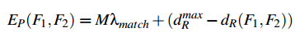
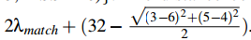
Mathematical Model of HMM in C-Track
Emission probability bjk = P(vk|sj ). Emission Score (F,G) is intended to be proportional to the likelihood that a fingerprint F is observed from grid cell G.
A larger emission score means that a cell is a more likely match for the observed fingerprint.
Our emission score uses the following heuristic.
We find Fc, the closest fingerprint to F seen in training data for G.
“Closest” is defined to be the value of Fc that maximizes a pairwise emission score EP(F,Fc).
Our pairwise captures both the number of matching cell IDs, M, between two fingerprints, and the Euclidean distance dR in between the signal strength vectors of the matching towers.
A higher number of matching towers, and a lower value of dR, both correspond to a higher emission score
λmatch is a weighting parameter
d^max_R = 32 is the maximum possible RSSI distance.
consider the fingerprints
{(ID=1, RSSI=3), (ID=2, RSSI=5)} and
{(ID=1, RSSI=6), (ID=2, RSSI=4), (ID=3, RSSI=10)}.
The weighting parameter affects how much weight is given to tower matches versus signal-strength matches: we chose λmatch = 3.
We normalize all our emission scores to the range (0,1) to ensure that they are in the same range as transition scores
II. SYSTEM OVERVIEW

Slide 14
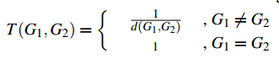
Mathematical Model of HMM in C-Track
Transition probability
d(G1,G2) is the Manhattan distance between grid cells G1 and G2 represented as ordered pairs (x1,y1) and (x2,y2).
The transition score is based on the intuition that, between successive time instants, the user either stayed in the same cell or moved to an adjacent cell.
It is unlikely that jumps between non-adjacent cells occur, but we permit them with a small probability to handle gaps in input data
II. SYSTEM OVERVIEW

Slide 15
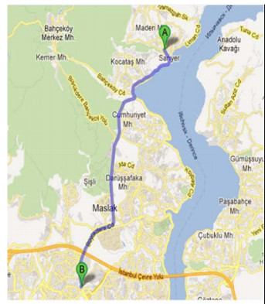
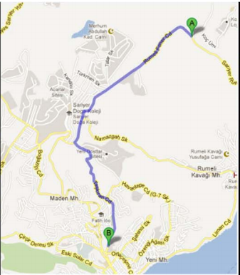
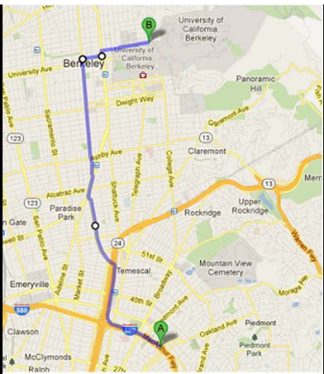
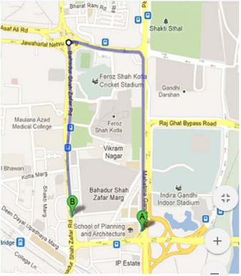
A standard Nokia handset operating in the 900-MHz band and connected to a laptop that runs network monitoring software
III. DATA COLLECTION
A sample of the RSSI signature containing the power levels & identifiers of the seven strongest base stations is reported once every 2 s along with the GPS latitude and longitude information, i.e., τ = 2 s
We collected data over four different roads
(a) Urban road with a length of 12 km between Sariyer and 4. Levent, Istanbul, Turkey
(b) Suburban road with a length of 4 km between Koç University and Sariyer, Istanbul, Turkey
(c) Suburban road with a length of 8.2 km between the University of California, Berkeley, CA, USA and Temescal, Oakland, CA, USA
(d) Suburban road with a length of 2.9 km in New Delhi, India.
III. DATA COLLECTION
Notes:
<number>

Slide 16
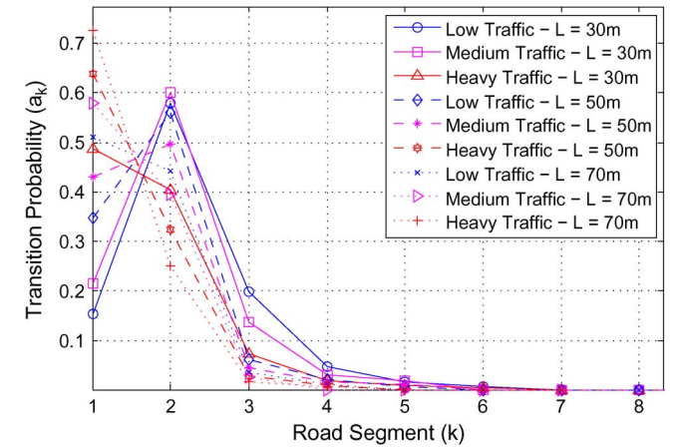
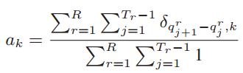
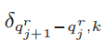
IV. ESTIMATION AND USAGE OF HIDDEN MARKOV MODEL STATISTICS
A. Training Phase
L denotes the length of the segment
The calculation of ak given the training database including the sequence of states recorded by GPS, i.e., Qr = (qr 1, qr 2,...,qr Tr ) for r ∈ [1, R], where qr i is the ith state in the rth run, R is the number of runs in the training data, and Tr is the number of data points corresponding to the rth run in the training data, is given as
the # of transitions of magnitude k
total # of transitions
the Kronecker delta function that takes the value of 1 if qr j+1 − qr j = k and 0, otherwise.
Probability of the transition to the following road segments at low-, medium-, and high-traffic conditions for the urban road of different segment lengths.
IV. ESTIMATION AND USAGE OF HIDDEN MARKOV MODEL STATISTICS
Notes:
<number>

Slide 17
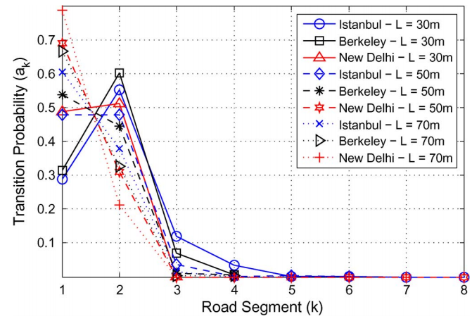
We observe that the transition probability significantly varies depending on the location and traffic conditions of the roads,
Contradicting the common assumption of the HMM-based localization literature that
the mobiles move only to the adjacent grid cells or adjacent road segments.
The analysis of many histograms of the observed RSSI values from many base stations shows that the histogram has a Gaussian shape if enough RSSI samples are collected from the base station in the corresponding road segment.
Probability of the transition to the following road segments for the suburban roads of different segment lengths.
IV. ESTIMATION AND USAGE OF HIDDEN MARKOV MODEL STATISTICS
Notes:
<number>

Slide 18
B. Tracking Phase
During the tracking phase, the mobile phone only sends the RSSI vector information to the central server
When given the sequence of the observed RSSI vectors, i.e., observations O = (O1, O2,...,OT ), where T is the number of observations, the server identifies the most likely sequence of the road segments traveled by the user, i.e., states Q = (q1, q2,...,qT ).
Since the parameters of the HMM are estimated during the training phase, the Viterbi algorithm is used to estimate the most likely sequence of the road segments.
IV. ESTIMATION AND USAGE OF HIDDEN MARKOV MODEL STATISTICS

Slide 19
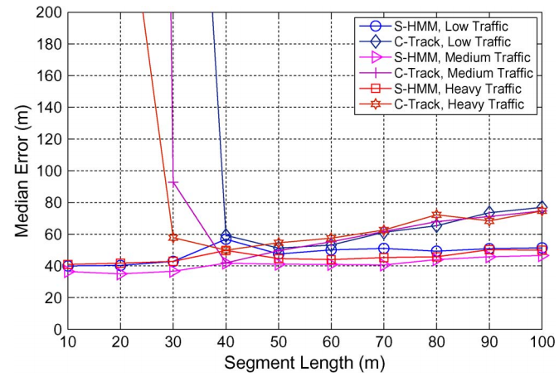
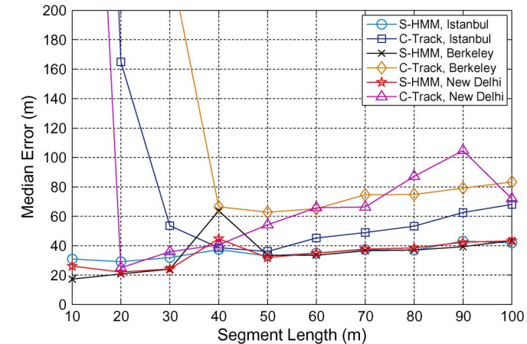
V. PERFORMANCE EVALUATION
A. Localization Error Comparison at Different Traffic Conditions in Different Locations
Comparison of the median error of the proposed S-HMM algorithm with the previously proposed HMM technique called Ctrack at low-, medium-, and high-traffic conditions for the urban road.
Fig. 5. Comparison of the median error of the proposed S-HMM algorithm with the previously proposed HMM technique called Ctrack for the suburban roads in different locations: Istanbul, Turkey, Berkeley, CA, USA, and New Delhi, India.
V. PERFORMANCE EVALUATION
V. PERFORMANCE EVALUATION

Slide 20
V. PERFORMANCE EVALUATION
A. Localization Error Comparison at Different Traffic Conditions in Different Locations
the median localization error for Ctrack is very large for small and large segment lengths,
S-HMM has a stable localization error due to the inclusion of the driver and RSSI statistics.
the median error of S-HMM is smaller than that of Ctrack for all segment lengths
C-Track: The cost of the observed RSSI vector is a weighted function of the Euclidean distance and the number of matching base stations between the observed vector and each RSSI vector in the training database.
Ctrack assumes uniform transition probability from the current grid cell to each of the adjacent cells and is adapted here for the localization on the road.
Comparison of the median error of the proposed S-HMM algorithm with the previously proposed HMM technique called Ctrack at low-, medium-, and high-traffic conditions for the urban road.
V. PERFORMANCE EVALUATION
Notes:
<number>

Slide 21
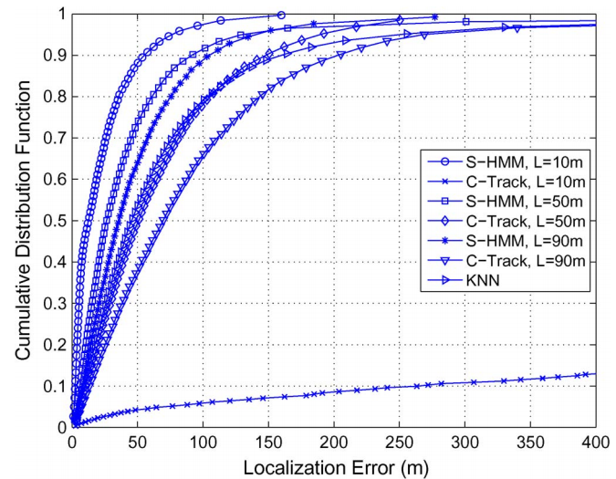
In the KNN algorithm, all the collected RSSI vectors and the corresponding GPS locations are stored during the training phase.
During the tracking phase, the received RSSI vector at an unknown location is compared with all the RSSI vectors stored in the database, and its location is estimated as the average of the GPS locations of the K-closest RSSI vectors in terms of Euclidean distance.
the localization error for S-HMM is always to the left of the Ctrack and KNN algorithms for all the segment lengths.
The cdf of the localization error for the urban road and suburban roads in Istanbul, Turkey, and in New Delhi, India exhibits a similar behavior.
V. PERFORMANCE EVALUATION

Slide 22
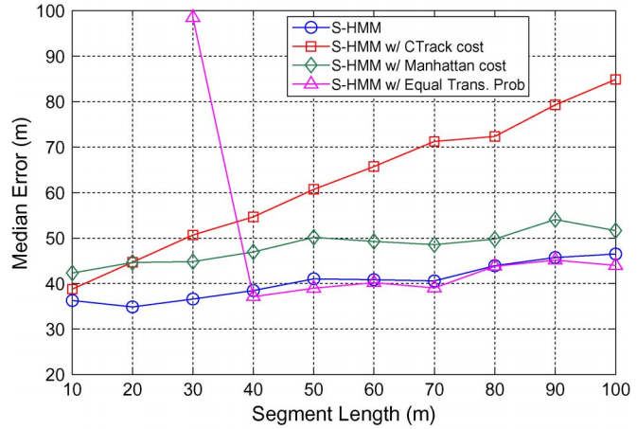
B. Effect of Including Driver and RSSI Statistics
Effect of including the driver and RSSI statistics on the localization error by comparing the performance of
S-HMM
variations of S-HMM, including different transition probabilities and different cost functions for the urban road at medium traffic in Istanbul, Turkey.
S-HMM uses driver and RSSI statistics to determine the transition probability matrix and emission probability of the HMM, respectively
S-HMM w/ Ctrack cost & S-HMM w/ Manhattan cost
driver statistics to determine the transition probability matrix
ctrack cost function & Manhattan cost for emission score
“S-HMM w/ equal trans.prob: uses RSSI statistics to determine the emission probability but uses uniform transition probability to the adjacent segments.
Ctrack cost performs worst as the segment length increases,
Manhattan cost is more stable but still performs worse than S-HMM.
The cost function is the main reason for the increase in the localization error of Ctrack as the segment length increases
The localization error of “S-HMM w/ equal trans.prob.” is smaller than that of S-HMM when the segment length is above 40 m
our implicit assumption of memoryless transitions between road segments in determining the statistics of the driver’s behavior loses validity as the segment length increases.
As the segment length increases, we may need to include the state duration density in the HMM.
S-HMM vs. “S-HMM w/ equal trans.prob.,”: the assumption of uniform distribution for the transition probability is the main reason for the steep increase in the localization error of Ctrack as the segment length decreases.
V. PERFORMANCE EVALUATION
Notes:
<number>

Slide 23
C. Energy Consumption Comparison
The cell phone is expected to operate in the tracking phase after a short training period.
The training can be also done by using some voluntary mobile phones only.
Since cell phones continuously track base stations as part of their normal operation, the marginal energy cost of the tracking phase is driven by the CPU load to process base station signatures and to send this information to the central server.
Processing a cell tower signature might require at most 100 000 instructions, which costs at most 30 μJ on an ARM Cortex-A8 processor.
The energy required to send the packets depends on how frequently the data are uploaded to the central server.
A negligible amount of additional power is consumed if the collected data are compressed using simple gzip compression and are sent every minute.
Acquiring cell-phone signatures with a period of 2 s therefore results in power consumption of 15 μW.
The power consumption of GPS on the other hand is measured to be around 400 mW, which is several orders larger than that of the GSM-based localization.

Slide 24
VI. CONCLUSION
We proposed a statistical fingerprinting approach to position a mobile device that follows any predetermined route by using RSSI measurements recorded from at most seven cellular base stations in the course of the normal operation of GSM-based mobile phones with minimal energy consumption.
We incorporate the route constraint for the motion of the vehicles by using an HMM.
We demonstrate that training the HMM based on the average driver statistics on the road and the probabilistic distribution of the RSSI vectors in each road segment
considerably improves the accuracy of the previously proposed HMM-based techniques
and provides localization performance robust over different segment lengths by using extensive cellular data collected in Istanbul, Turkey; Berkeley, CA, USA; and New Delhi, India.
Notes:
<number>

Slide 25
Ctrack— Accurate, Low-Energy Trajectory Mapping for Mobile Devices

Slide 26
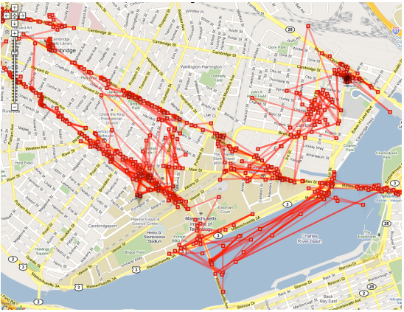
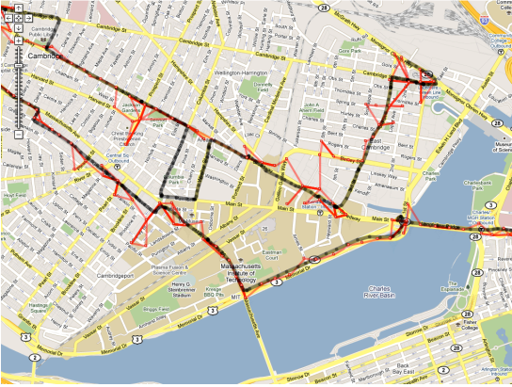
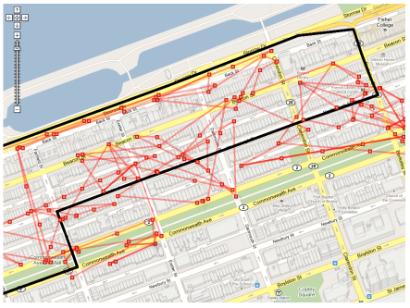
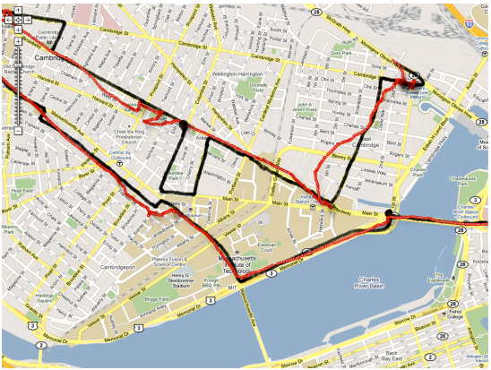
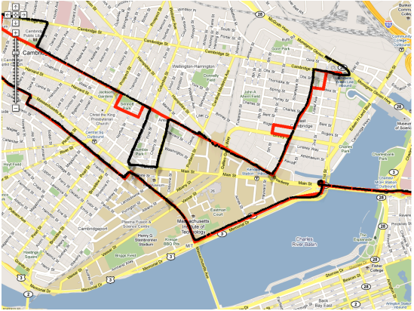
(a) Raw points before sequencing
(b) After Grid Sequencing
Figure 1: GSM Localization Errors. Raw location samples are in red and the true driving path is in black
(c) After smoothing
(d) Final map-matched output

Slide 27
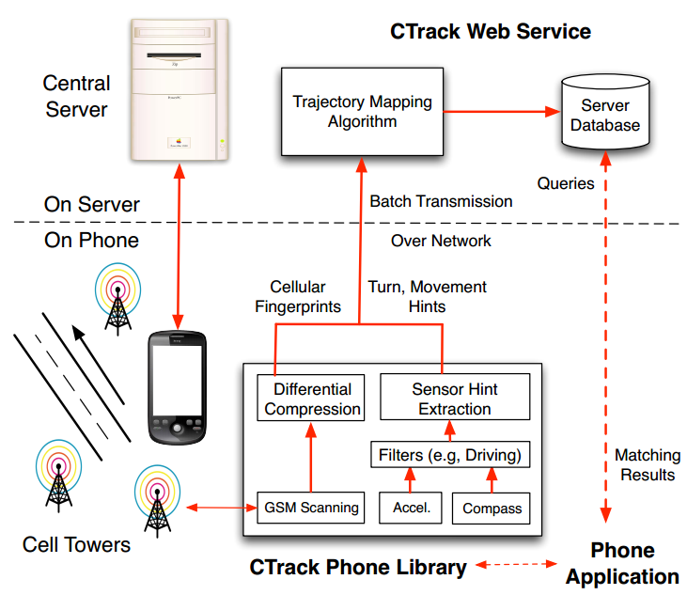
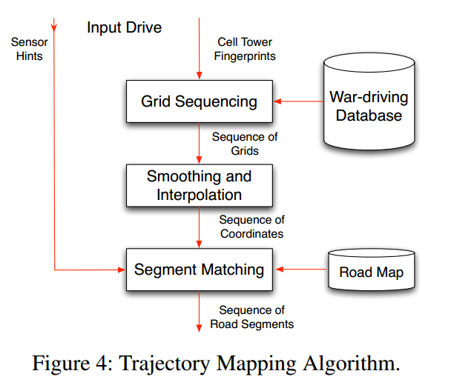
Figure 3: CTrack System Architecture.

Slide 28
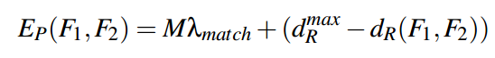
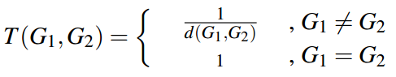
Grid Sequencing
Grid sequencing uses a Hidden Markov Model (HMM) to determine the sequence of grid cells corresponding to a timestamped sequence of cellular fingerprints
Windowing (phone typically sees all nearby cell towers within 3 scans, which takes about 5 seconds)
Hidden States (grid cells)
Emission Score:
M: number of matching cell IDs, λmatch: weighting parameter,
dR: Euclidean distance, need normalize
{(ID=1, RSSI=3), (ID=2, RSSI=5)} and {(ID=1, RSSI=6), (ID=2, RSSI=4), (ID=3, RSSI=10)}
Transition Score
Notes:
d(G1,G2)曼哈顿距离 λ[match] = 3 d[R][max] = 32
<number>

Slide 29
Smoothing and Interpolation (grid sequence → coordinates sequence)
Smoothing filter:
centroid of the training points seen from the grid
smoothing low-pass filter with a sliding window, calc centroid of centroids in each window (to deal with back-and-forth transitions between grids )
Interpolation
linearly interpolate these points to obtain points sampled at a 1-second interval
This component takes a grid sequence as input and converts it into a sequence of (lat,lon) coordinates that are then processed by the Segment Matching stage.
Notes:
窗口大小 W[smooth] = 10；1s一次的原因：每段路至少一个点 最短路段30m 最大速度29m/s， 速度更快的长度超过30m
<number>

Slide 30
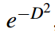
Segment Matching
Segment Matching maps sequenced, smoothed grids from the previous stages to road segments on a map
States {S,HM,HT }
Emission score of a point (lat,lon,HM,HT ) from a state (S,HM2 ,HT2 )
If HM != HM2 or HT != HT2 , Emission score = 0
Else , D is the distance of (lat,lon) from road segment S
Transition score: {S1,HM1 ,HT1}, {S2,HM2 ,HT2}
0 if segments S1 and S2 are not adjacent
Else 1 * λmovement (0.1)* λturn (0.1)
Speed constraint
Notes:
H1M = HM2 = 0 and S1 != S2 ; transition represents a turn, but the sensor hints report no turn
<number>

Slide 31
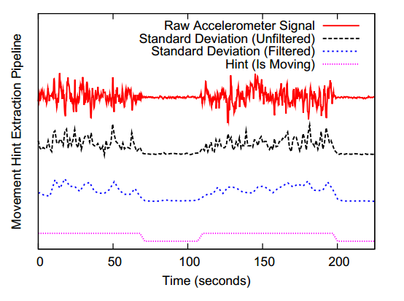
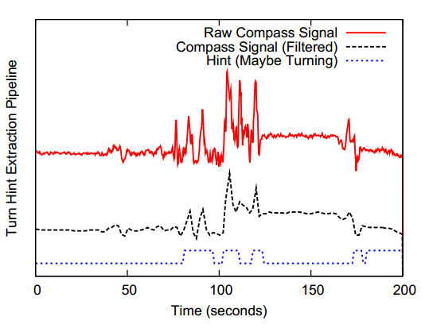
SENSOR HINT EXTRACTION
Movement Hints
standard deviation of the 3-axis
EWMA filter
Threshold σmovement
Turn Hints
true change in orientation manifests as
a persistent, significant, and steep change in
the value of the orientation sensor
median filter
Notes:
只在手机与移动物体相对静止时才使用
<number>

Slide 32
EVALUATION
Data
126 hours of real driving data in the Cambridge-Boston area
15 Android G1 phones and one Nexus One phone over a period of 4 months
Collect cell tower fingerprint every second, and the accelerometer and compass at 20
1,718 km of driving, and 560 km of distinct road segments Hz
857 distinct cell towers

Slide 33
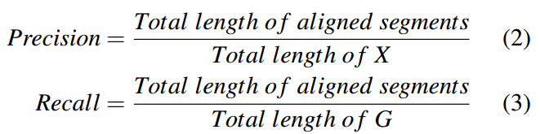
Metrics (precision, recall, and geographic error)

Slide 34
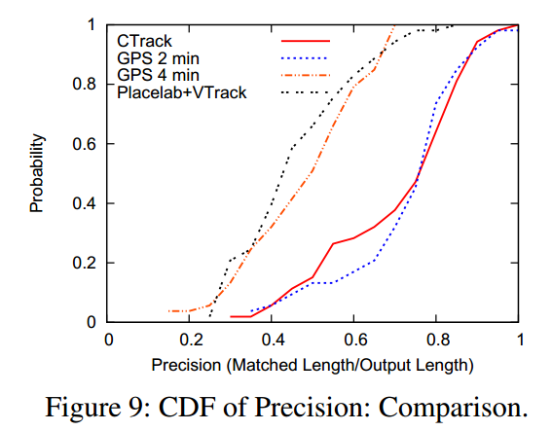
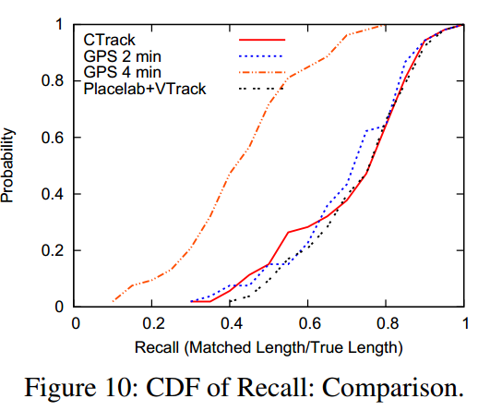
Notes:
右图gps-4 预测错转弯点
<number>

Slide 35
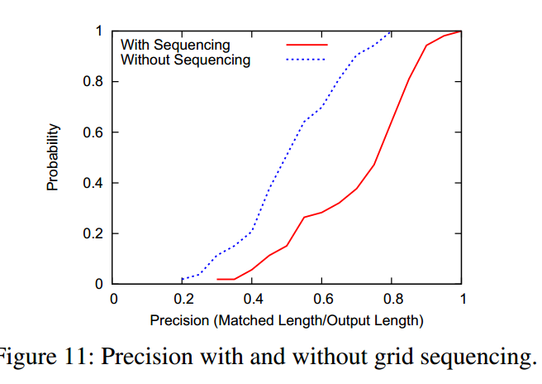
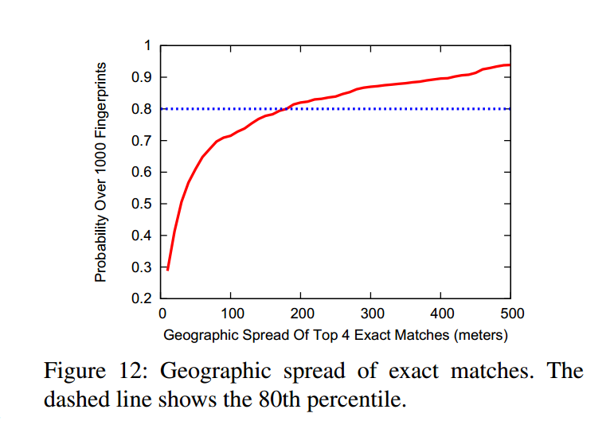

Slide 36
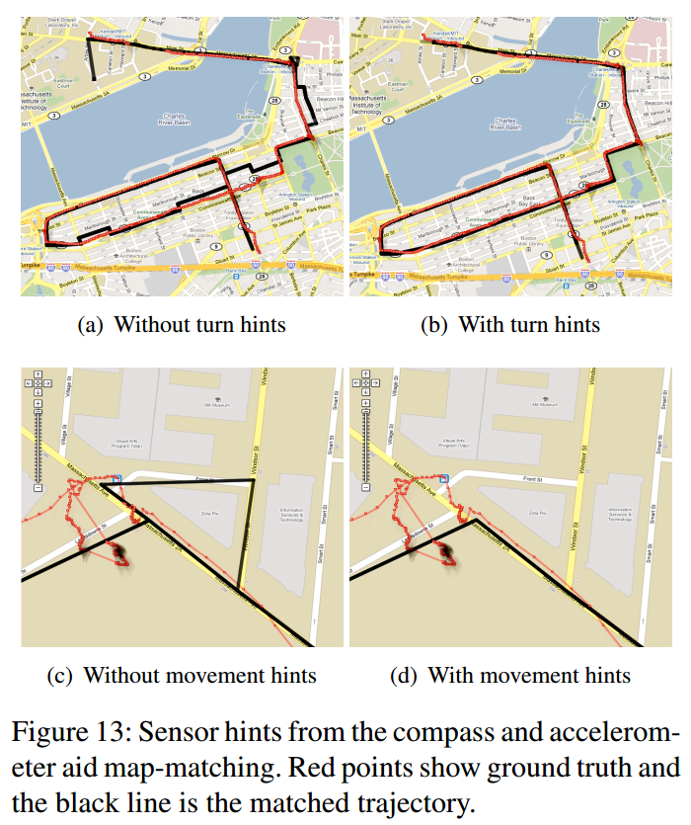
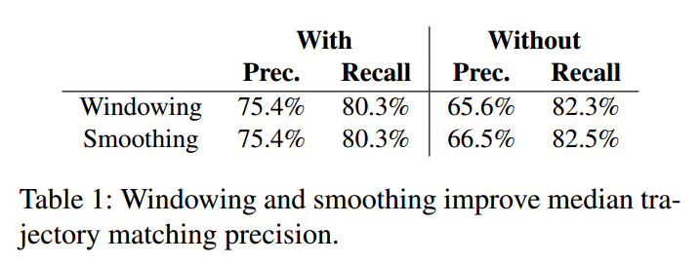

Slide 37
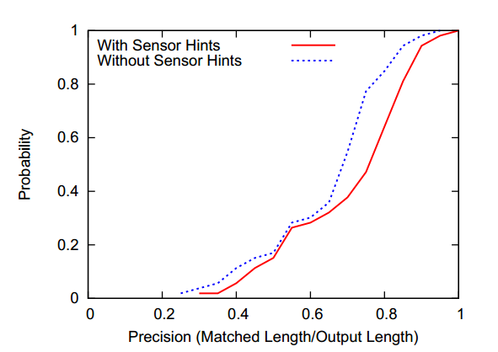
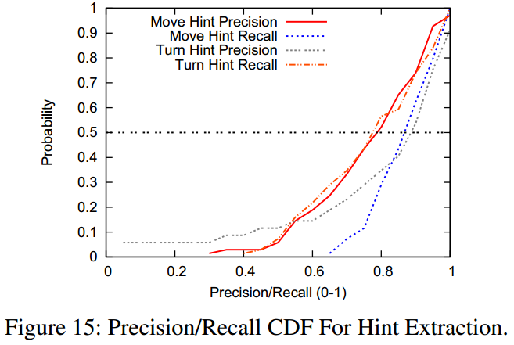

Slide 38
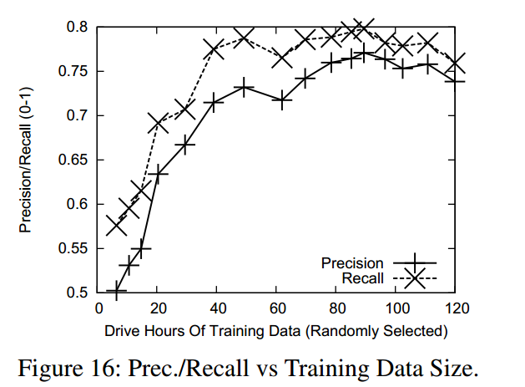
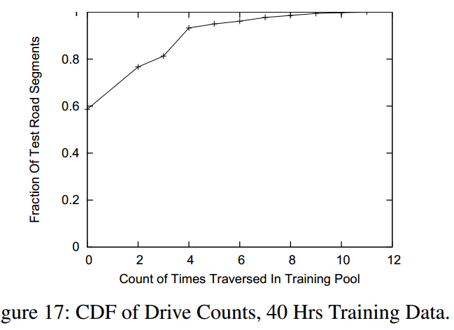
Notes:
40 hour
<number>

